Slide 1
OOP
Object Oriented Programming - it is a paradigm or style of programming where , program/code is centered around the object rather than the functions.
Languages that support OOP are
JAVA
C#
PYTHON
Ruby
And many more …

Slide 2
Pillars of OOPs
Encapsulation
Polymorphism
Inheritance
Abstratction

Slide 3
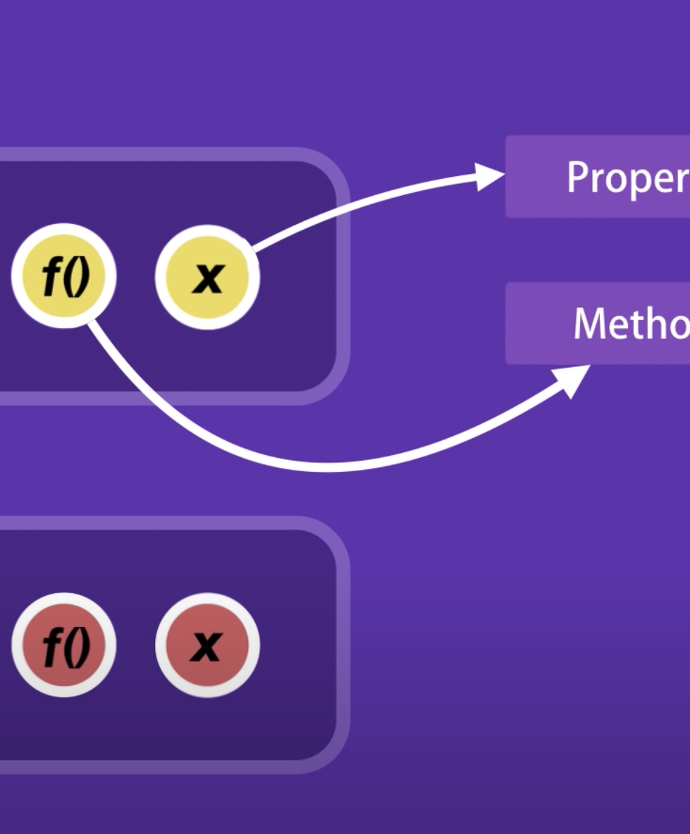
Encapsulation
In OOP , we keep a group of variables and functions which are related to each other , bundled together in an object .
Variables → properties
Functions → methods

Slide 4
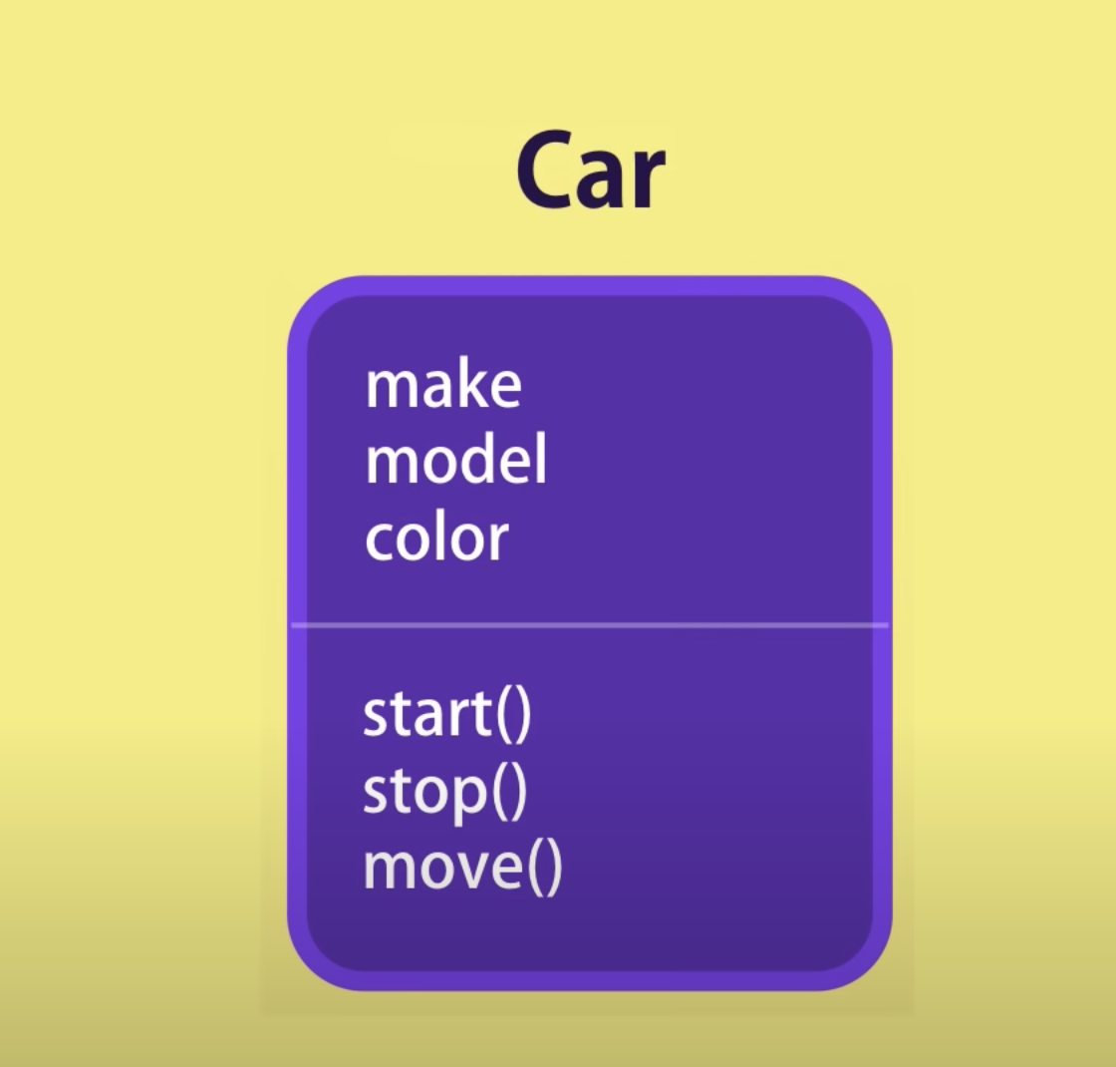
Example in Real time
Car
Local storage

Slide 5
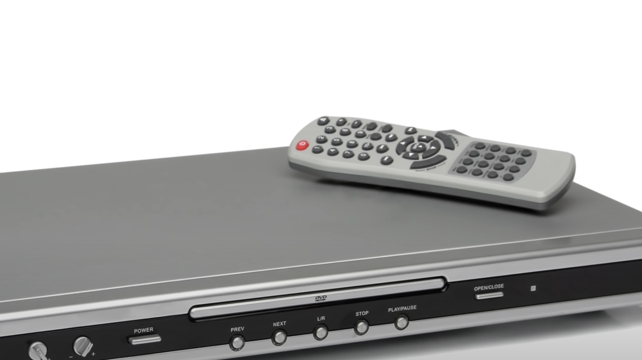
Abstraction
It is a way of hiding the the implementation details, complex logics and showing only the functionality to users

Slide 6
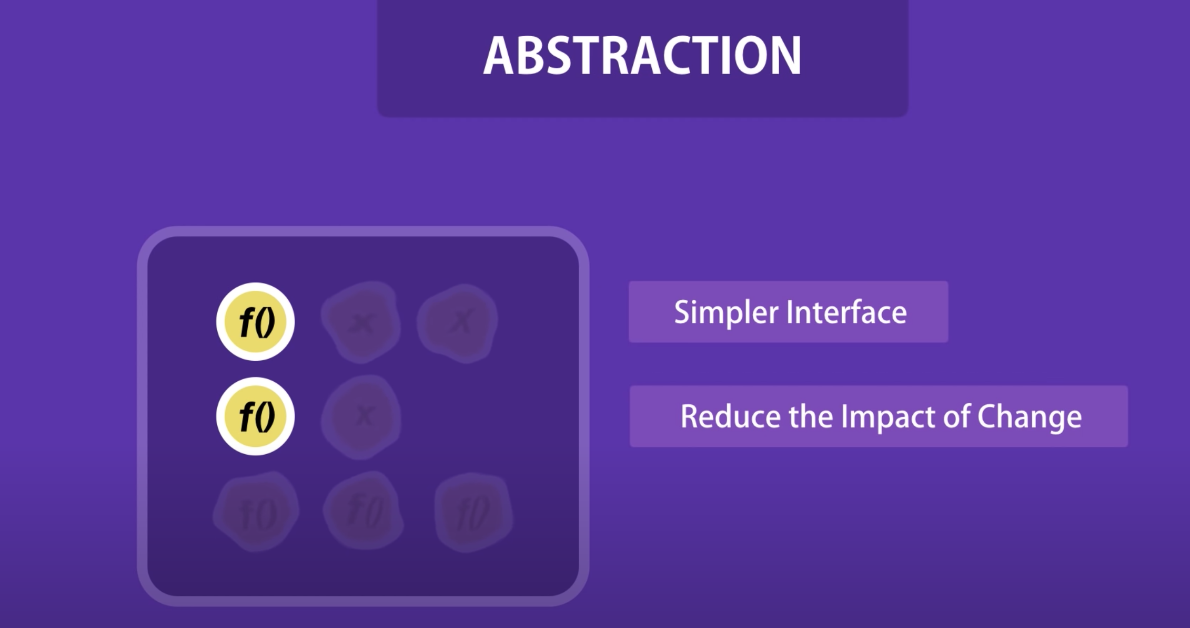

Slide 7
Inheritance
Parent –> child class
Base → derived class
Super → sub class
Process of eliminating the redundant code ,
Ability where one class inherit the properties from another class.

Slide 8
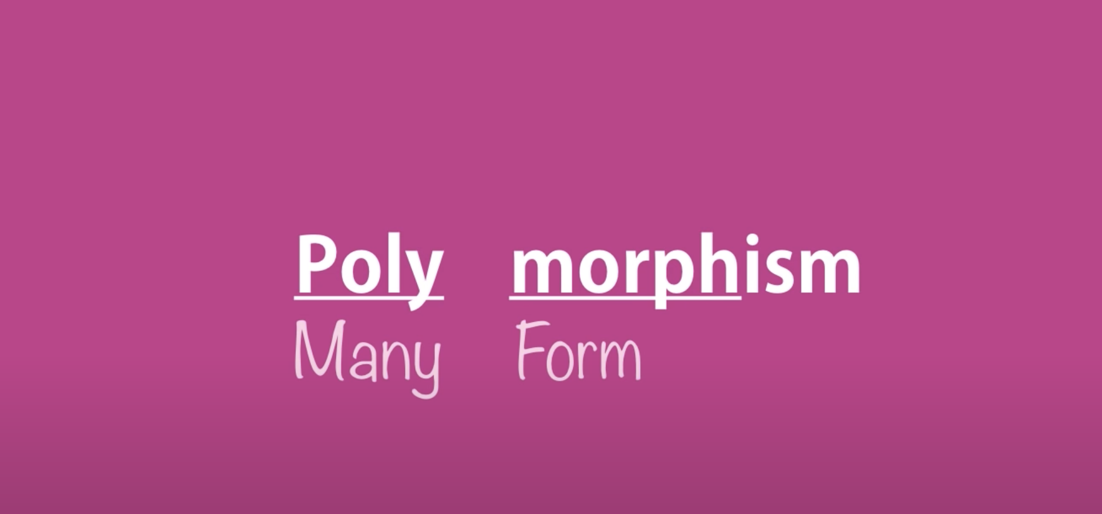
Polymorphism
Ability to create a variable, function or object which has multiple forms

Slide 9
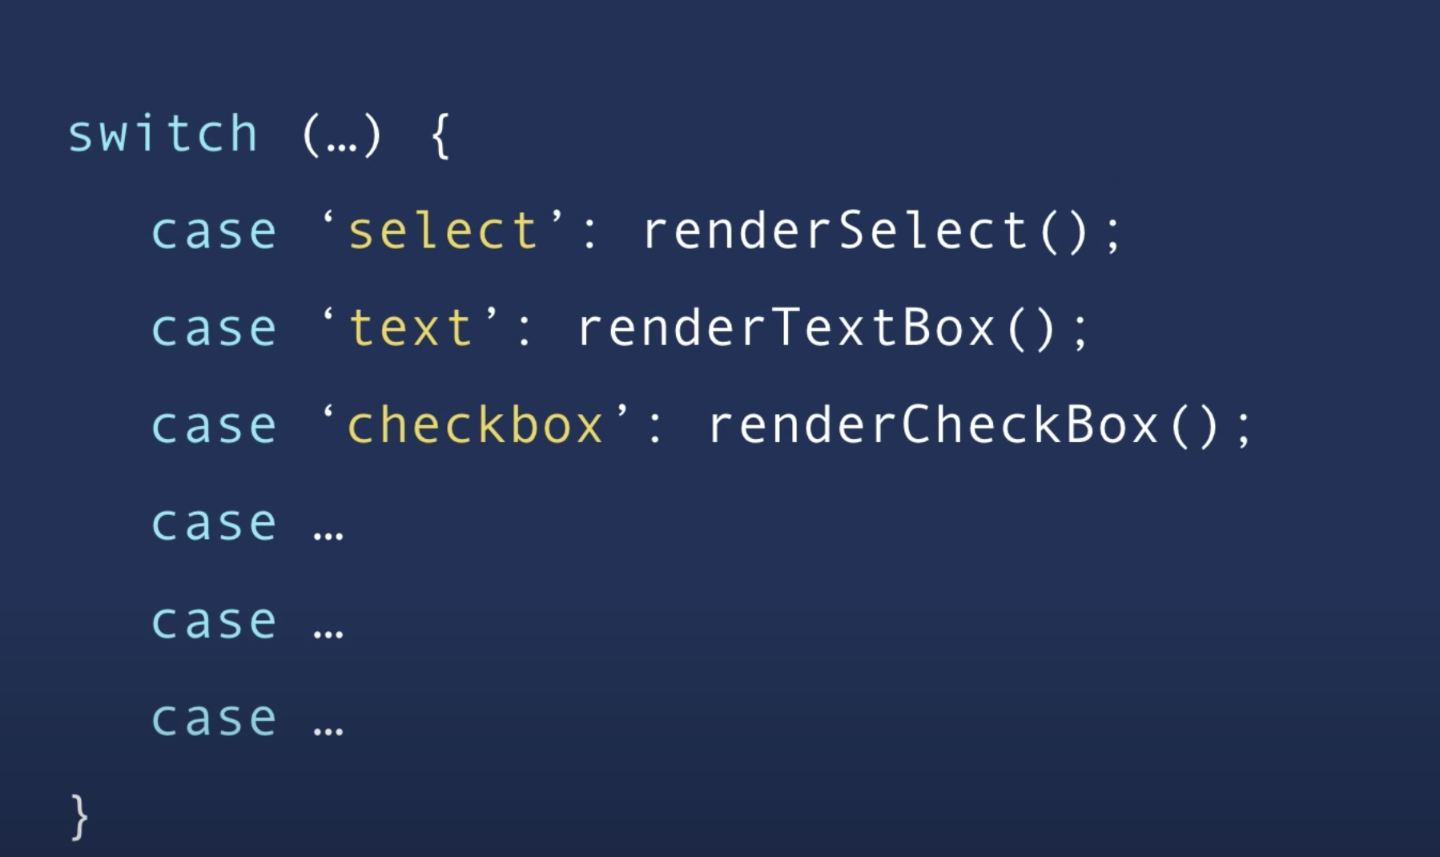
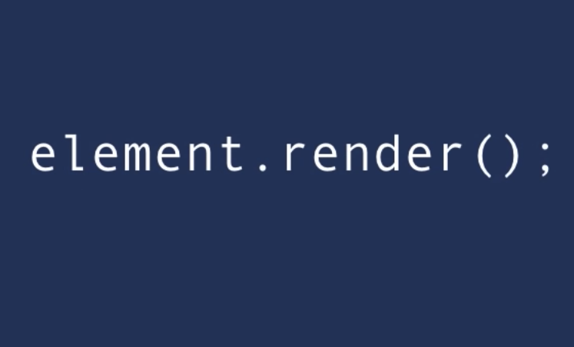
With polymorphism we can have a render method for each of the HTML element .

Slide 10
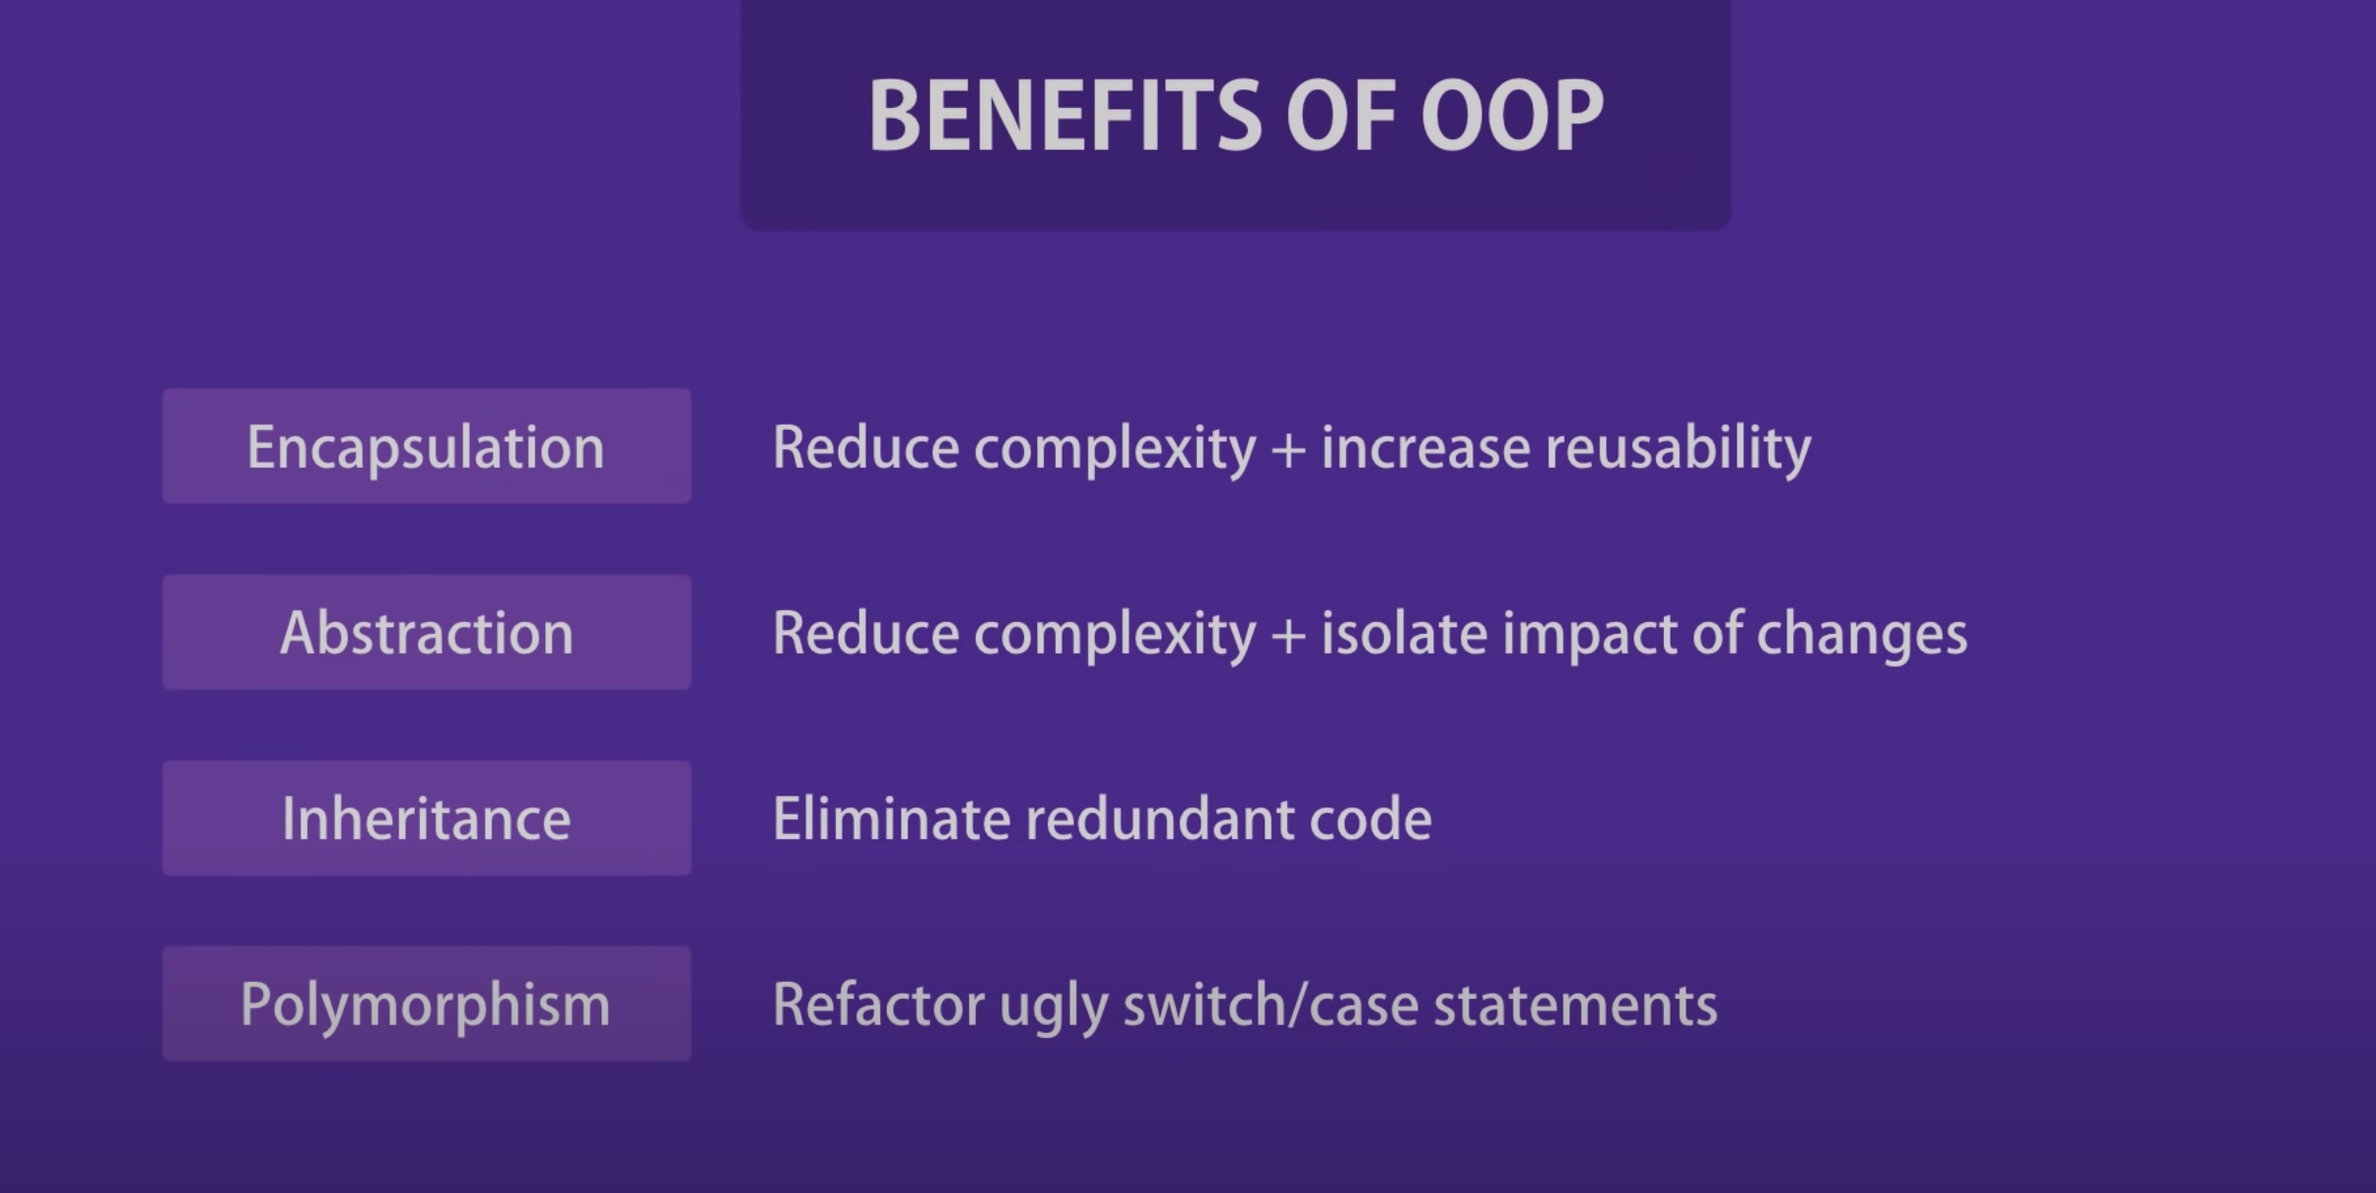
Benefits

Slide 11
Objects
Creating objects
Factories and constructors
Primitive and Reference types
Working with properties
Private properties
Getters/setters

Slide 12
In JS, every object has a constructor property, and which constructor is used down the hood the construct that object
List of built in constructor
new String // '' " " ``
new Boolean // true false
new Number // 1,2, 3
new Object // {}
New Function

Slide 13
Everything in JS is Objects
Functions → Objects
Arrays → Object

Slide 14
Primitive V/S Reference type
Primitive
String
Number
Boolean
Undefined
Symbol
Null
Reference Types
Object
Functions
Arrays

Slide 15
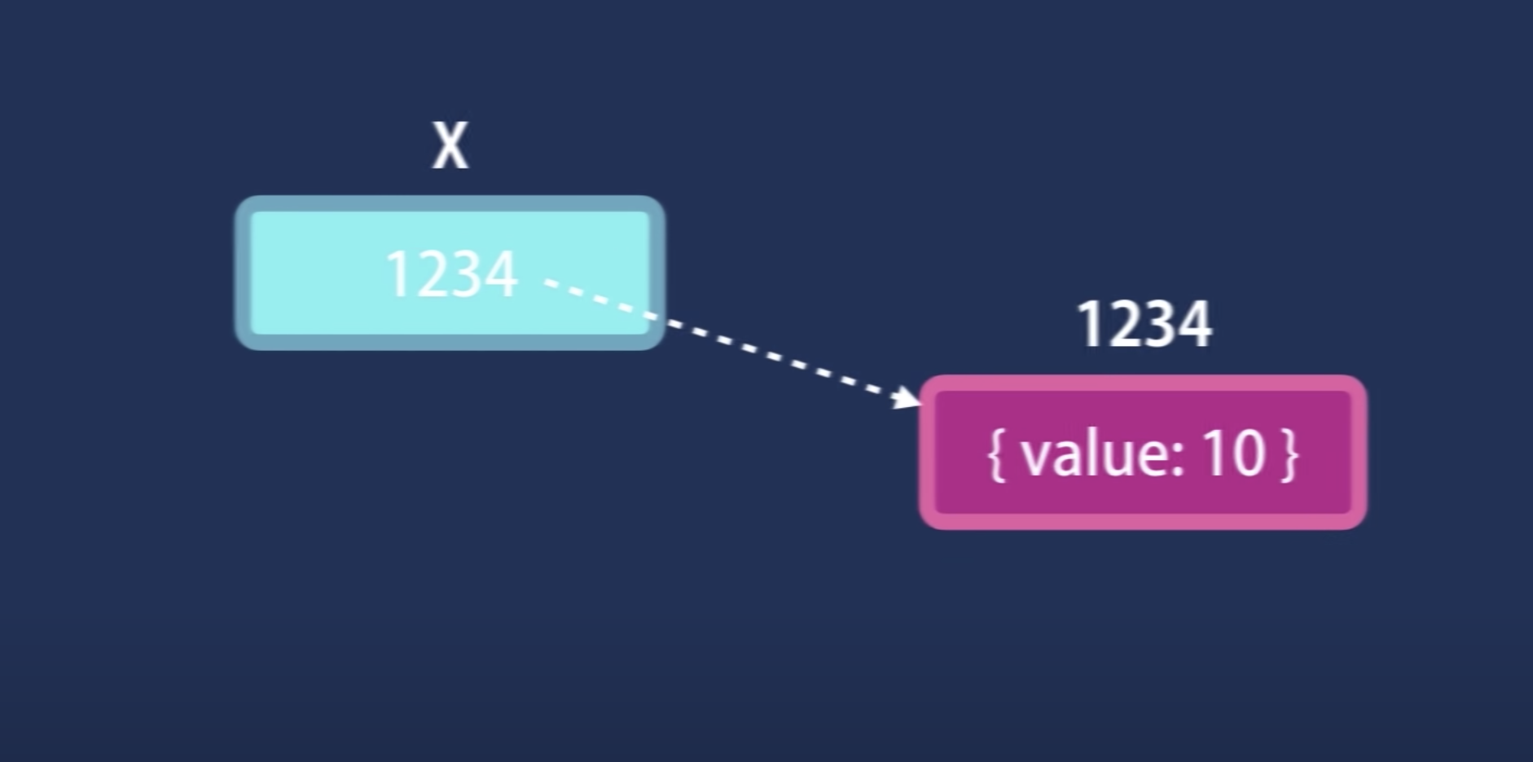
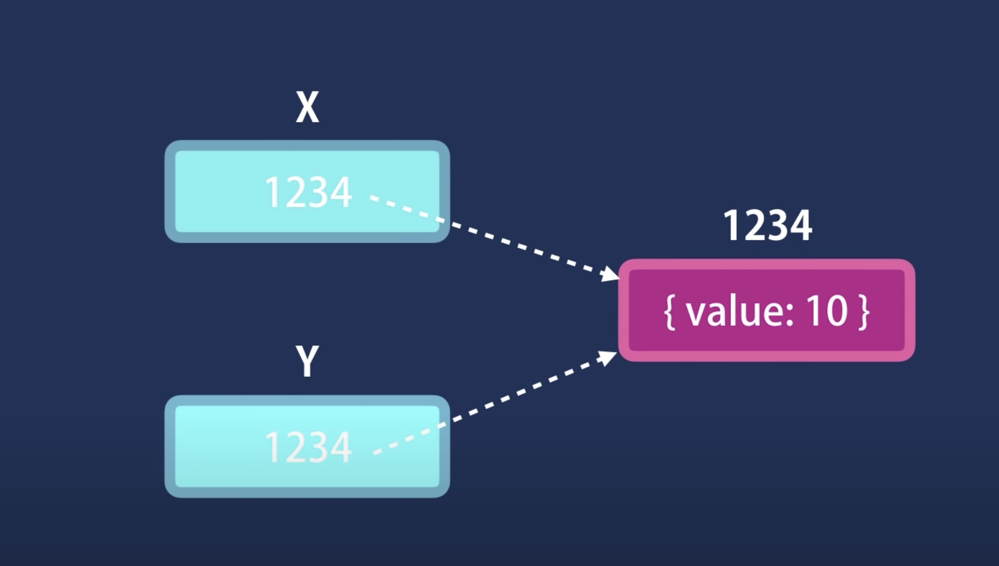
Copy by value/refernce
Primitive types are copied by value
Reference types are copied by reference

